Slide 1
How to help our Earth
By the Lorax

Slide 2
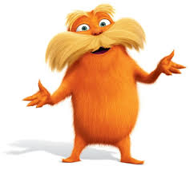
Hello! I am the Lorax. I speak for the trees, and the fish and the birds, and I am asking you please to help out the Earth.

Slide 3
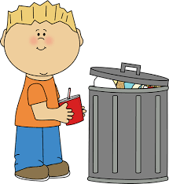
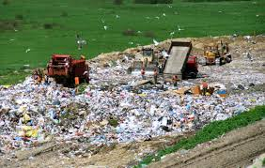
First, I have a question, and I need to ask it. Do you know where the trash goes that is in your wastebasket?

Slide 4
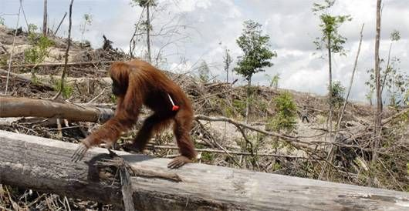
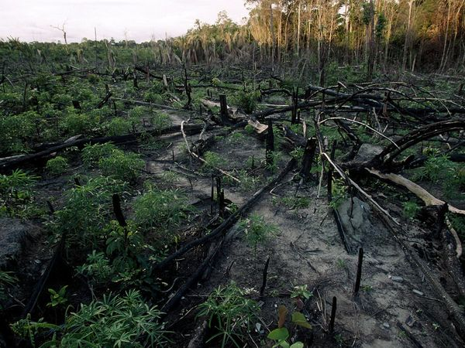
Do you know?
WHY we cut down trees?

Slide 6
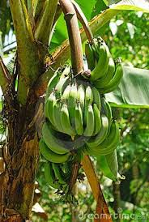
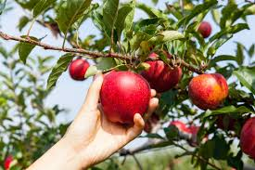
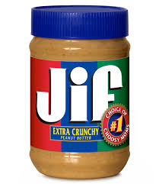
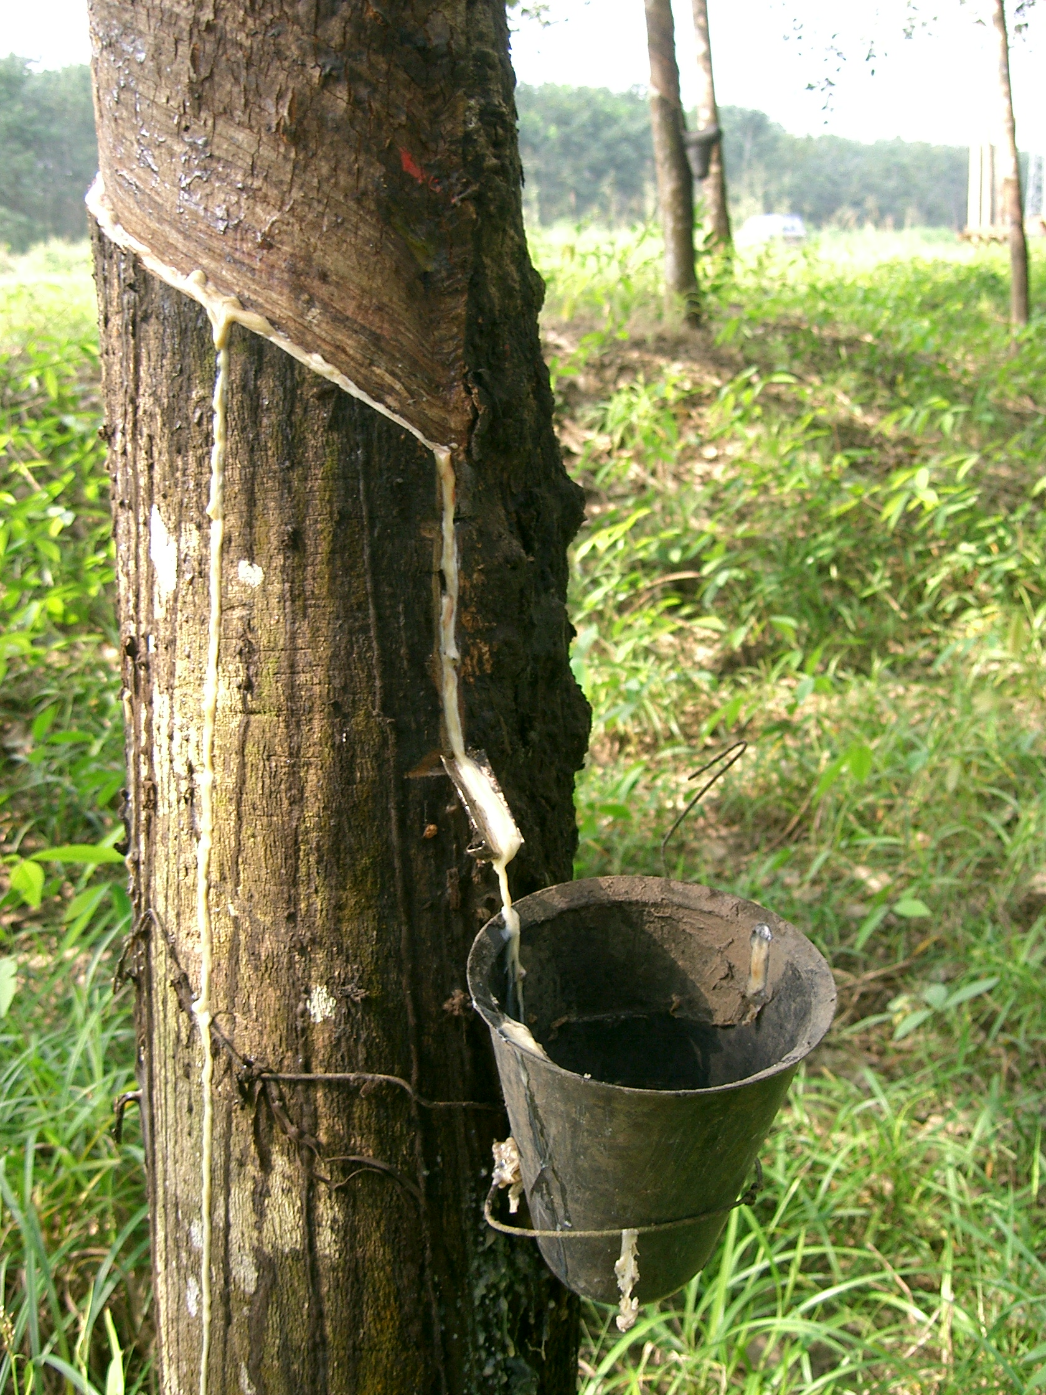
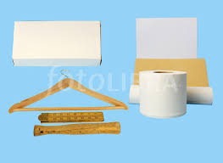
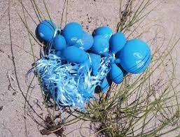

Slide 7
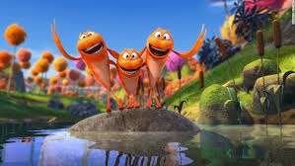
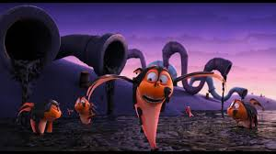
Animals and plants - all things alive - need to have water. It’s how we survive.

Slide 8
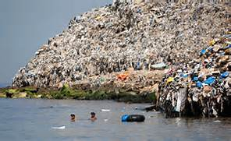
Did you know?!
It takes 500 to 1,000 years for plastics to break down. And over the last 10 years we have produced more plastic than the last 100 years put together

Slide 9
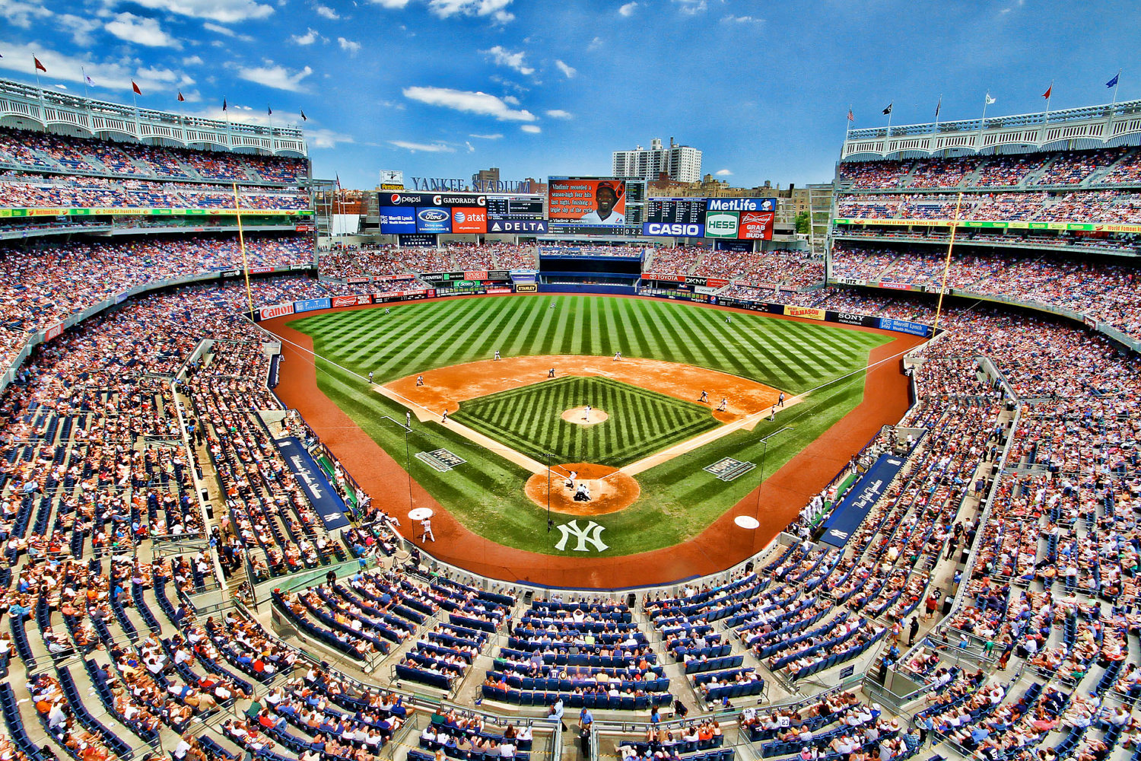
Did you know?!
Americans use so many plastic straws, they could fill up Yankee Stadium 9 times each year。

Slide 10
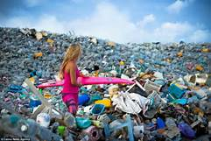
Did you know?!
10% of the plastic we use yearly end up in the ocean. That’s equivalent to 700 billion plastic bottles!

Slide 11
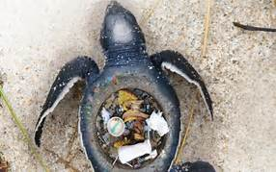
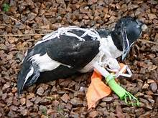
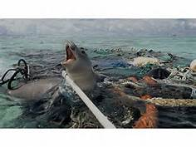
Did you know?!
More than a million seabirds and 100 million marine animals die each year from plastic pollution?

Slide 12
So what can YOU do?
Answer: DON’T USE PLASTIC!!!

Slide 13
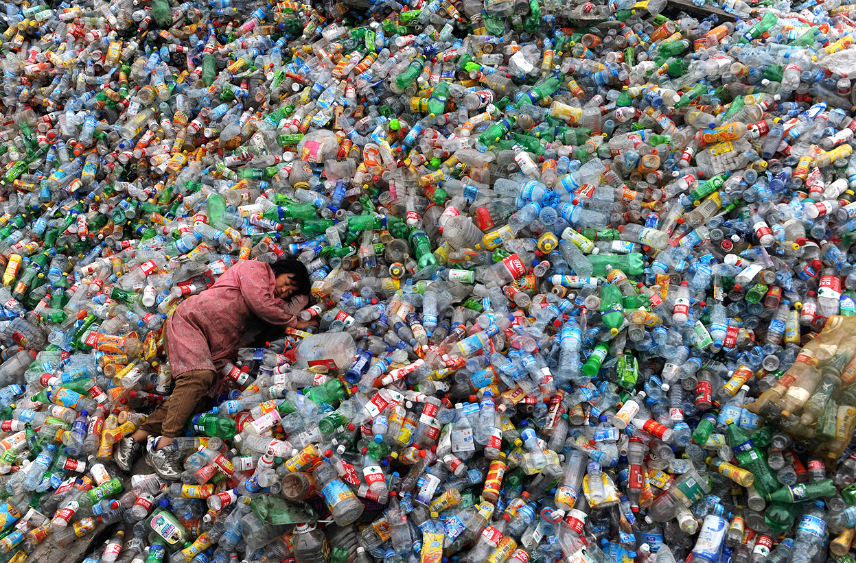
Use reusable items, such as glass, BPA free, or stainless steel water bottles. DO NOT buy single use plastic bottles!

Slide 14
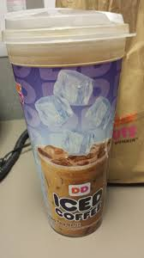
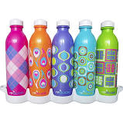
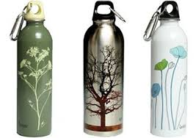
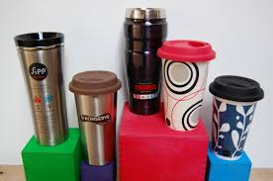
Use refillable water bottles and cups when buying drinks.

Slide 15
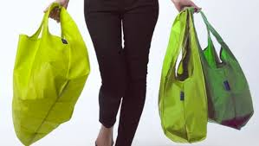
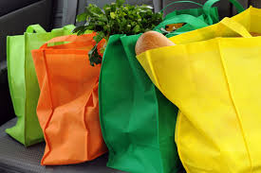
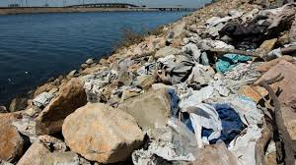
Use reusable bags when shopping!

Slide 16
Save paper! Use both sides, recycle paper, and use reusable towels.

Slide 17
Check out sites like freecycle.org and second-hand shops, instead of buying new clothes.

Slide 18
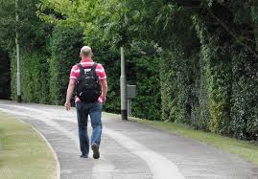
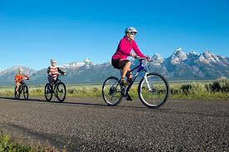
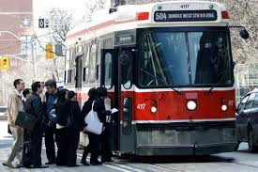
When possible, choose public transportation, walk, or bike to your destination!

Slide 19
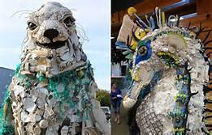
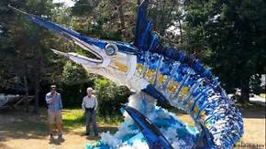
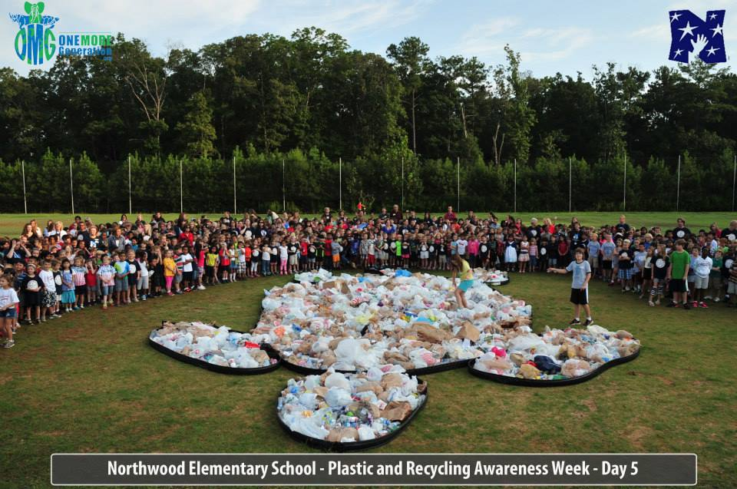
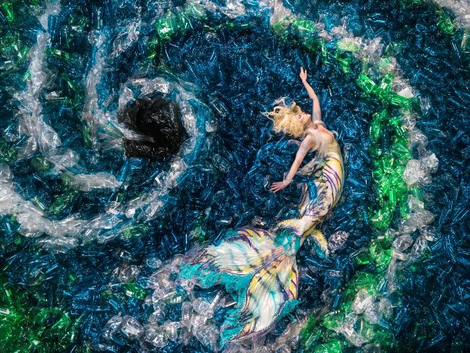
Spread awareness through education.

